Slide 1
Academic Reading & Writing
Unit 6: Cultural Orientation Programs

Slide 2

This Week
Last week we covered this paper’s Introduction, Methods, and Results
This week we will look at Discussion, and Abstracts and Title Pages

Slide 3

Unit 6 – Reading Quiz
We will have our usual quiz on reading content and vocabulary
Some questions may have more than one answer - you must select all correct answers to receive full marks
The link will be posted to the WeChat group
You have 20 minutes

Slide 4
Discussion
What do you think might be the limitations of the present study and their implications for future research?
Is the U-Curve Hypothesis valid?

Slide 5
The pre-sessional group were significantly more homesick than the standard arrival group. They also had a higher level of psychological distress and reported a more negative evaluation of their experiences in the UK. The hypothesis that the PSG would experience less culture shock than the SAG after one academic term should therefore be rejected. Indeed the students who attended the pre-sessional course displayed more symptoms of culture shock than a group of students that arrived on their own and took no part in any cultural orientation. This could be explained in a number of different ways.
Page 179-180

Slide 6
It could be argued that the students who are attracted by, or are encouraged to participate in, the pre-sessional course are more likely to have difficulties when the academic term begins. However, as reported above, participation in the course is mainly determined by whether a student’s sponsor is prepared to bear the cost, rather than by the student’s individual wants and needs. Further, the SAG was selected to resemble the PSG as closely as possible on variables that might have been expected to affect the experience of culture shock e.g. age, country of origin, religion, place of residence.
Page 180

Slide 7
Is it then realistic to suggest that the course made students more homesick? It could be argued that the orientation course creates a false sense of security and that students arriving on their own are more likely to make an effort to get to know people and to become familiar with their new environment.
It must be pointed out that the central aim of the pre-sessional course is not to prevent culture shock. The publicity surrounding the pre-sessional course promotes it primarily as a study skills course. No measures of academic achievement were taken in this study and therefore it is not known whether or not the course improved academic performance. […] The pre-sessional course was also consistently praised by participants and regarded as a crucial part of their orientation to the university. Nevertheless, the literature would suggest that elements of the course would significantly help a student in the process of cultural adaptation.
Page 180

Slide 8
In their methods of coping the students adopted consistent strategies, turning to the familiar and maintaining contact with home and family. A striking feature throughout the interviews was that students did not turn to the structured support that was available at the university. Some students interviewed were not even aware of the existence of the University Counselling Service
Page 181

Slide 9
A relationship was found between the degree of discrepancy between expectations and experiences, and homesickness. Students who had experiences that did not match up to their expectations, whether or not they were on the pre-sessional course, were more homesick than other students. This result supports work by Fisher (1990) on homesickness and expectations. It also has implications for the way that universities recruit international students. As competition increases for a share of student numbers marketing techniques could become more aggressive, but these should not distort expectations of living and studying in a foreign country. Accurate information before departure and on arrival at the university is obviously essential.
Page 181

Slide 10
One consistent finding from the interviews is that there was not one isolated phase of feeling low. In the words of one student “Homesickness is something that comes and goes in waves”. However nearly all subjects reported that the most difficult time for them was the first few days. Rather than experiencing an initial ‘honeymoon period’ many students were totally disoriented at the start of their time in the UK.
This information runs counter to the U curve hypothesis. Despite the fact that this model is still replicated in the research literature and literature for professionals working with international students, it is clear from the information in this study that the students’ experience is much more complex and is related more to the personal and social factors affecting each individual.
Page 181-182

Slide 11
Culture shock in the context of international students can be seen as an ongoing process. The psychological effects are intermittent and are intensified by personal and social factors affecting each individual. The student, unlike an immigrant, is a sojourner and will stay only temporarily in the host culture. The student is therefore preoccupied with the academic task in hand and outside cultural influences are regarded as a secondary factor. International students are not only adapting to the British culture, but perhaps primarily they are adapting to British university culture. Added to the difficulties of leaving home and family are the stresses brought on by academic study.
Page 183

Slide 12
On the basis of our findings we would recommend that the following could be considered by staff in higher education institutions, in addition to the provision of initial cultural orientation programmes: – A more sophisticated analysis of the problems and needs of individual international students, relevant to the local higher education environment. – The development of coherent management strategies to support international students. Support is often provided by several agencies within institutions in a relatively uncoordinated and unstructured way. Communication between these agencies, and between them and students, tends to be poor.
– A support system that would address student needs all year round.
Page 183

Slide 13
In conclusion, this study suggests that the present model of culture shock used by the professionals at universities and colleges of higher education is unhelpful. The use of cultural orientation or ‘culture learning’ in a short course at the commencement of a student’s visit, does not seem to be a solution to the difficulties faced by international students.
Page 184

Slide 14
Question
What do you think might be the limitations of the present study and their implications for future research?
Is the U-Curve Hypothesis valid?

Slide 15
Collocation Exercise – Use these word to fill in the sentences on Page 190
Propose | Replicate | Validate
Discrepancy | Exclude | Devise
In Accordance With | At Large | Map Out

Slide 16
Propose | Replicate | Validate
Discrepancy | Exclude | Devise
In Accordance With | At Large | Map Out
1) A method _____________ for quicker communications between offices.
2) This group is not representative of the population _______________.
3) The government has issued a new document ________________ its policies on education.
4) Researchers tried many times to _________________ the original experiment.
5) This product can only be used _______________ the manufacturer’s instructions.

Slide 17
Propose | Replicate | Validate
Discrepancy | Exclude | Devise
In Accordance With | At Large | Map Out
6) In his speech, he _________________ a financial incentive for schools to take on poorer performing students.
7) Microbes must, as far as possible, ______________ from the room during an operation.
8) There is a large __________________ between the ideal image of motherhood and the reality.
9) The data is ______________ automatically by the computer after it has been entered.

Slide 18
Title Pages
Functions and Steps

Slide 19
Steps to Writing a Title Page
A title page is often the first thing your reader will see
At the very least, you need to have the project title and author name – need to know who wrote the paper
Step One to writing a title page is to finish writing the paper – decide on the final title when the underlying work is complete

Slide 20

Step Two – Proper APA Header Format
In your document, the title page will go on Page 1
In the header, type “Running head:” followed by the title of your paper in uppercase letters and left justify (align to the left)
At the end of title, insert the page number and align to the right (in most word documents this will count automatically on each page

Slide 21
Step Three – Title Page Content
Use 1 inch margins, 12 point font, and double spacing
Write the title of your paper about halfway down the page – this should not have more than 12 words per line, or include abbreviations and words with no purpose
Type the author’s name: First name, middle initial, last name (Do not include titles or degrees)
Type the school or institution related to the research or where the research was conducted
For school projects, you can include the course name, instructor, and submission date

Slide 22
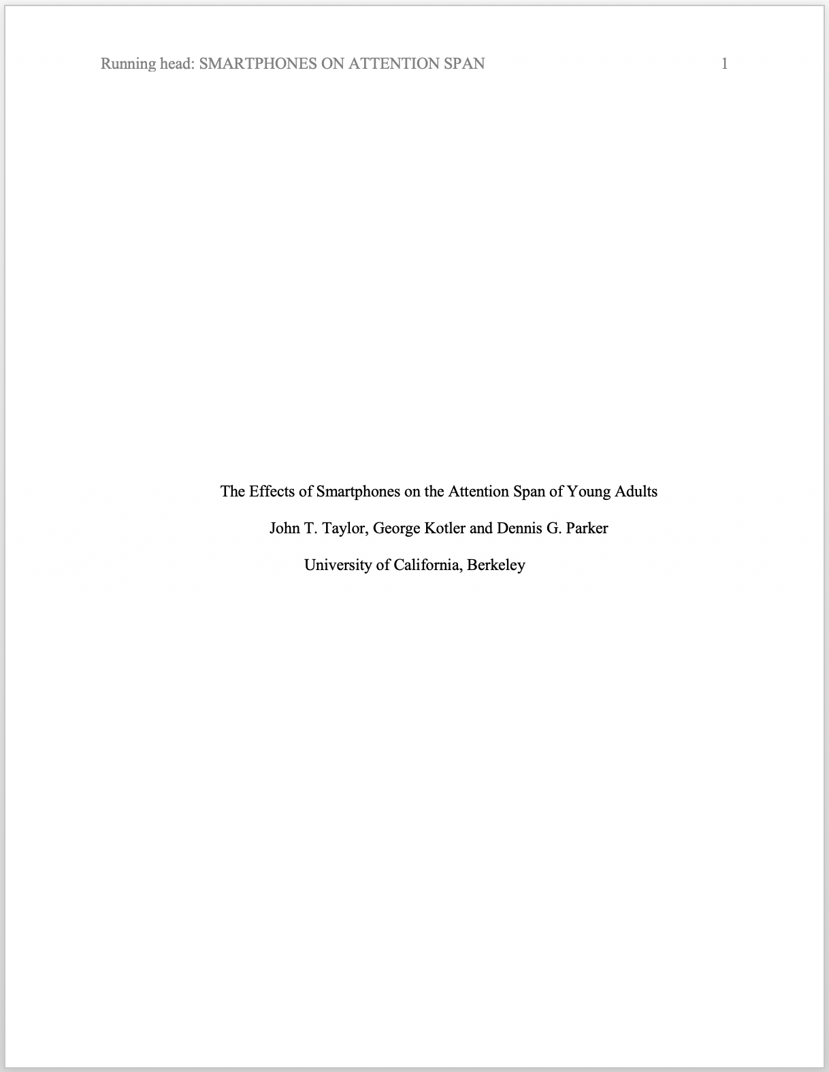
Header
Page #
Title
Authors
Institution

Slide 23
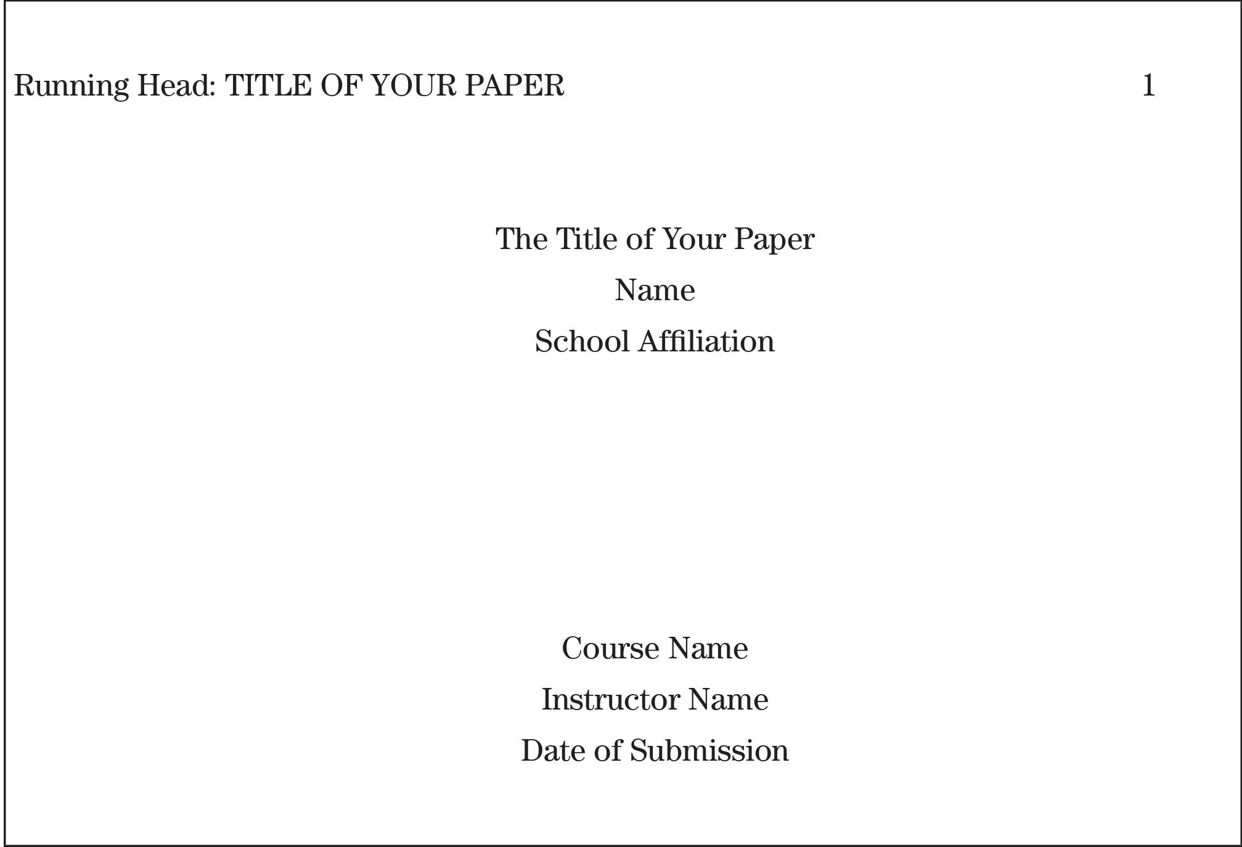
For schoolwork, insert below

Slide 24
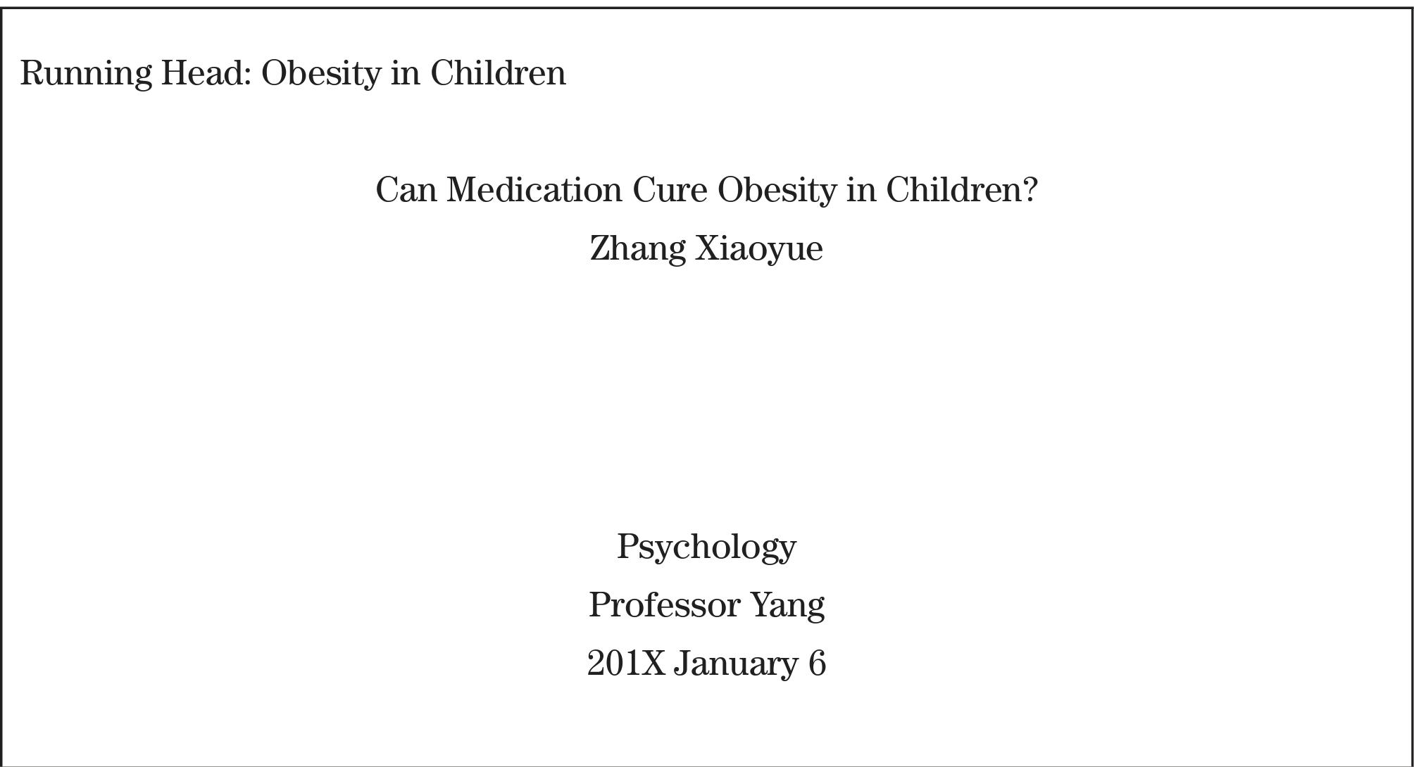
Are there any formatting errors with this title page?

Slide 25
Grammar Question
What is the plural of Research?
Researches is a verb, not usually a noun (He researches black holes)
What are some other examples of words like this?

Slide 26




Water
Sand
Space
Time

Slide 27
General And Abstract Terms
Abstract Terms(抽象词): Honour, Diligence, Talent, Happiness, Sentimentality, Love
General Categories(集合名词): Music, Art, Advice, Money, News, Furniture, Research
When we want to refer to large general categories of countable nouns, we use the plural (The car / Cars [车辆])

Slide 28
Review: Countable & Uncountable nouns
Nouns are either countable, uncountable or both*
*If they are both, the meaning will be different for each

Slide 29
Example: Both countable and uncountable
It will take time to change people’s opinions on the subject.
时间
I visited Sydney several times during my stay in Australia
次/趟

Slide 30
Why is this important?
This determines:
How our verbs agree with our countable/uncountable subjects
Whether we need articles (general/non-count do not)
Which words we use to talk about them

Slide 31
For example, few / a few years ago there were not many microwave ovens in our country.
Technology brings much / many advantages to our lives.
I think many / a lot of research must be done on organic farming.
Unfortunately I have little / a little time to cook when I get home.

Slide 32
Abstracts
Functions and Steps

Slide 33
Abstracts
An abstract is a concise, comprehensive summary of the contents of the research paper that allows readers to survey the contents of your paper quickly. It is also used by abstracting and information services to index and retrieve articles.

Slide 34
Step One
Step one is just like the title page: finish the research paper first
You need to know the content of your paper, from methods to discussion, to be able to summarize it

Slide 35
Step Two: APA Formatting
The abstract begins on Page 2, after the title page
The header from the title page should continue across the top, including page numbers
The first line of the page should say “Abstract” (No other formatting: italics, bold, quotation marks etc.)
One inch margins, 12-point font, and double spacing

Slide 36
Step 3: Write the Abstract Content
The abstract should make up a single block paragraph with approximately 50 to 250 words
Write a concise summary of the key points of your research, which contains your introduction, research questions, participants (if any), methods, results/findings, conclusions, and (if room) implications
On the line after your abstract, type “Keywords:” and list up to five relevent keywords related to your research (all italicized)

Slide 37
Exploring University Students’ Perceptions of Plagiarism: A Focus Group Study 2
Abstract
Plagiarism is perceived to be a growing problem and universities are being required to devote increasing time and resources to combating it. Theory and research in psychology show that a thorough understanding of an individual’s view of an issue or problem is an essential requirement for successful change of that person’s attitudes and behaviour. This pilot study explores students’ perceptions of a number of issues relating to plagiarism in an Australian university. In the pilot study, focus groups were held with students across discipline areas, year and mode of study. A thematic analysis revealed six themes of perceptions of plagiarism: confusion, fear, perceived sanctions, perceived seriousness, academic consequences and resentment.
Keywords: academic integrity; college students; plagiarism; student ethics; university student

Slide 38
Different Elements
Introduction
Methods
The purpose of the present paper is to provide…
With the aim to provide…, we have...
This paper presents a detailed analysis/methodology of...
We use…to investigate the...
We have developed a…to study/estimate/investigate the...
Our research/study uses a(n)…approach...

Slide 39
Different Elements
Results
Discussion/Conclusion
Our findings/results suggest/indicate/show...
Some of our important findings include…
The results we obtained demonstrate that...
These results support the idea that…
In this study, we present/propose…
And in the present study, we attempt to use an alternative theoretic framework to examine…

Slide 40
Abstract
‘Culture shock’ has been identified as a psychological reaction to a change in cultural environment. The main symptoms of culture shock are reported to be psychological disturbance, a negative reaction to the new surroundings and a longing for a more familiar environment. Research has identified culture shock as a component, in the difficulties that international students face when studying in another country. One way that institutions of higher education have responded to these difficulties is to provide initial cultural orientation. In the study reported here, a group of post-graduate students who had participated in a study skills and cultural orientation course at a British university were compared with a group who had not. Contrary to the research hypothesis, the group that took part in the orientation course were significantly more homesick and reported more psychological difficulties. The overall findings cast doubt on the received view of culture shock as it affects international students. They suggest that culture shock is exacerbated by personal and social factors and this has implications for the way that international students may be helped through the experience.

Slide 41
Abstract
This paper investigates the effect of the computer dictionary and the paper dictionary on L2 learners’ vocabulary acquisition while reading. Thirty-seven Korean college students divided into a computer dictionary group and a paper dictionary group read a short text for comprehension with access to a dictionary and were tested on the retention of the 14 target words. The results show that (1) while L2 learners read a short text, they look up significantly more words using the computer dictionary than using the paper dictionary, (2) the computer dictionary has a more positive effect on learners’ incidental vocabulary acquisition by drawing learners’ attention to the words than the paper dictionary, and (3) there is no difference in the retention rate between the words looked up in the computer dictionary and those looked up in the paper dictionary.

Slide 42
Abstract
In second language (L2) writing research it is essential to focus on the learners’ writing processes to understand their L2 vocabulary use; namely, limitations, choices, and misunderstandings. This article offers an overview of learners’ Spanish-English online dictionary use in relation to L2 writing tasks, the strategies being used, and the limitations encountered while on task. The diverse data collection techniques—written texts, verbal protocols and interviews—provide a holistic view of students of Spanish as a foreign language in their online dictionary use, as well as information about the learners’ reflections on their dictionary use. Results do not only indicate that learners use the dictionary to find a word they did not know, to check their spelling, or to ascertain the meaning of a word, but also to express themselves better or translate the complexity of their English thoughts into Spanish. However, the texts they produced result also from their limited ability in the dictionary use and inability to transfer known strategies from their first language (L1) to their L2. Finally, certain pedagogical implications are discussed to help learners achieve a better command of the dictionary.

Slide 43
Abstract
In this study, I investigated the nature of communication between home and school in families who recently immigrated to Canada. I used an open-ended questionnaire in interviews of 21 Chinese immigrant families and 19 non-immigrant European-Canadian families. The immigrant parents’ pattern of communication differed from that of nonimmigrant parents: immigrant parents communicated less frequently, had more difficulty comprehending the communication, and were less satisfied with the communication. The immigrant parents especially emphasized the academic progress of their children and were concerned with the quality of teaching.

Slide 44
Task Two (Pg. 195)
There are eight sentences on Page 195 that come from an abstract
Use the content and structure to guess which elements (Introduction, Result, Methods etc.) each sentence represents
Then decide which order the sentences come in.

Slide 45
________________In addition,most students in the CW condition found the experience enjoyable and felt that it contributed to their L2 learning.
______________Results of the study showed that CW had an overall significant effect on students’ L2 writing; however, this effect varied from one writing skill area to another. Specifically, the effect was significant for content, organization, and vocabulary, but not for grammar or mechanics.
__________________This study investigated the effectiveness and students’ perceptions of collaborative writing (CW) in second language (L2).
__________________A number of theoretical and pedagogical implications of the study, and limitations and directions for further research, are presented.

Slide 46
(5) _____________The study involved 38 first year students in two intact classes at a large university in the UAE (United Arab Emirates). One class consisted of 18 students and was considered the experimental group, and the second consisted of 20 students and was considered the control group. In the control group, writing tasks were carried out by students individually; in the experimental group, these tasks were carried out in pairs.
(6) _______________Writing quality was determined by a holistic rating procedure that included content, organization, grammar, vocabulary, and mechanics.
(7) _______________Results of the study are discussed in light of the social constructivist perspective of learning.
(8) ______________The study lasted 16 weeks and involved a pre- and post-test.

Slide 47
Task 2 Part 4 (p.195/196)
Assemble the provided sentences into a complete abstract using the correct formatting
Once complete, imagine a title for this research project, and on the page before the abstract, write a title page using the APA format from this chapter
Use your own name and university for the extra information
You can submit the final combined document on the learning platform before next class

Slide 48
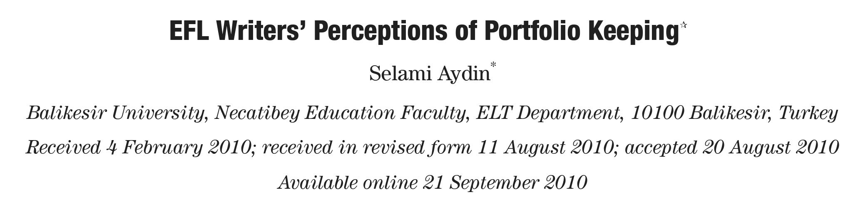
Next Week
No Quiz Next Week
We’ll Review Some Writing Points for the Final Paper

